Slide 1
Introduction to Software Engineering
Project one Presentation

Slide 2
Presentation
This presentation is a documentation of the highly effective and user friendly online repository(CPENspace) for undergraduate students in the University of Ghana, Legon.
Stay with us to the end to know what CPENspace was developed to do as well as how you can use it to your benefit, thank you.

Slide 3
A summary of the task are outlined as follows:
1. Design an interface using HTML, CSS and Bootstrap
2. Create a Django Project
3. Create an APP for Users and another for Dashboard
4. Create a User Registration and Login Authentication System for the entire web application
5. Use the concepts in CRUD to provide an avenue for an administrator to add project work report of students in PDF file format onto the web application.
6. Use the concepts in CRUD to provide an avenue for users to read published project work reports.
7. Use a PostgreSQl database for this project

Slide 4
Project Description
Graduate Students in the University of Ghana after completing their final project have their report published on the University of Ghana UGSPACE website (http://ugspace.ug.edu.gh/). However, for undergraduate students, only hard copies of their work is taken and packed on shelves in the Department Office. There are no digital means of accessing undergrad project report online and this has become a burden for the department since finding space for the increasing number of hard copy project report has become a daunting task. As a software engineer, you are to develop a system that addresses the problem.
Objectives:
The main objective of this project is for students to develop a web application using the Django Framework. In the course of this project, students are expected to leverage on the concepts and skills from the task project and apply same into building an Online Repository for the Computer Engineering Department.

Slide 5
points to cover:
Software development cycle
Model used
UML use case
UML sequence diagram
Functional requirement
Non-functional requirements
Tools and resources used
Role of individual team members
Project cost estimation
other relevant information

Slide 6
Software development cycle
1
Software is a set of programs targeted at performing a specific task and the process of developing this efficient program is software engineering
The software development life cycle(SDLC) is a framework defining tasks performed at each step in the software development process. The life cycle defines a methodology for improving the quality of the software and the overall development process.
Having a sound understanding of the SDLC, we followed through with the stages to bring up with this piece of work.

Slide 7

our team
went through the various phase of the development cycle.
1. At the requirements stage, we elicited information from the the clients description of the problem, went through a number of times, understood the issue to be handled and, captured the requirements(both functional and non-functional) of the system to be developed.
2. We then proceeded to the specification phase. Here we looked at what is expected of the system, its functionality, constraints as well as the input data and the required output data. We then planned on how to start where we distributed the various interfaces among the team and once done we came together to put the whole system together.

Slide 8
3. At the design phase, we made use of our Unified Modeling Language(UML) diagrams to give us a clearer understanding of how the system should function in time, who is going to use and how the system and the user co-relate.

Slide 9
Nothing makes an engineer more productive than , the last minute
Anonymous.

Slide 10
model used.
The cpenspace software was designed through the implementation of the waterfall model. This first led us to gathering the clients requirements at the beginning of the project ,then a sequential plan involving specification, design,implementation and integration was accommodated in the project.

Slide 11

4. Implementation Phase
Using the UML use case and sequence diagrams, we implemented our design.
our implemented design went through a number of reviews to ensure it was efficient and reliable. During this stage, it broke down a few times, made it difficult to fix some bugs and finally everything was resolved for us to present to you this software system.
some of the test case we performed was with the user authentication, where we played around with some details and accounts to see how our system would respond. where necessary, the user was unable to log in, messages were printed...

Slide 12
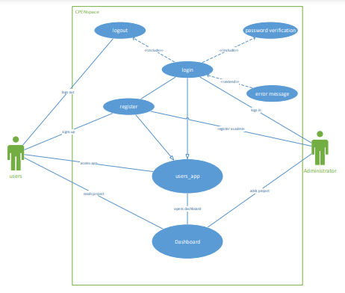
UML-use case

Slide 13
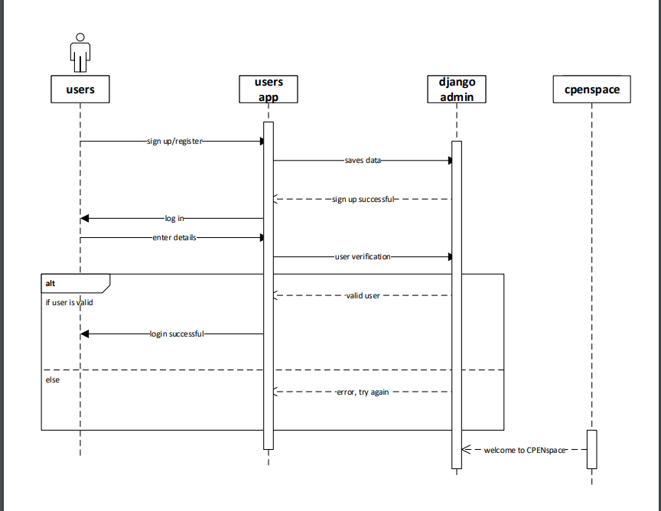
UML-sequence Diagram

Slide 14

5. integration and testing
We run a few tests on our system during the implementation face all of which our system passed.
NB: testing was done at every stage of the process.
Due to time constraint, we could not fully integrate our system but we have reason to believe that the client will be pleased with our work.
6, 7. maintenance and retirement
we hope to maintain this system for a good time and when necessary retire it and replace it with a more improved system.

Slide 15

The non functional requirements are:
the system is fast hence has a good performance, it is portable as it can be hosted on different browsers and operating systems, high security, highly user-friendly, and reliable.

Slide 16
Functional and non-functional requirements:
The CPENspace system has a users app to register and authenticate users, thus it able to moderate who has access to the content in the repository, as well as a dashboard to hold and organize the content of the repository. It provides an administrator who can alter the content in the repository.
sign up
users app/&
Dashboard
login
logout

Slide 17

Tools and resources used.
IN putting the CPENspace site together, we used the following tools and resources:
Visual code text editor,
bootstrap,
Django framework
Python programming language
microsoft visio
online resources such as slidesCarnival to produce this awesome slides, etc

Slide 18
Project cost and other relevant information
00
This project was built mainly with open-source online resources and free tools with the greatest cost invested being the time and commitment of the team members of the Great Mates

Slide 19
Team Great Mates
Afia Dabanka Akyaa- Leader
Obed Nuertey - Leader
Francis Quarshie - Leader
Quartson Jerry Justice - Leader
Each member was actively involved throughout the project lifetime, and this in-house commitment led to the great output we all see today.
Big Shouts to the Great Mates Team

Slide 20
Thanks!
Any questions?
We are happy to have them.

